Slide 1


Robotic Arm BCI
309
8 Credits
6/05/2021
Robotic Arm BCI
‹#›

Slide 2

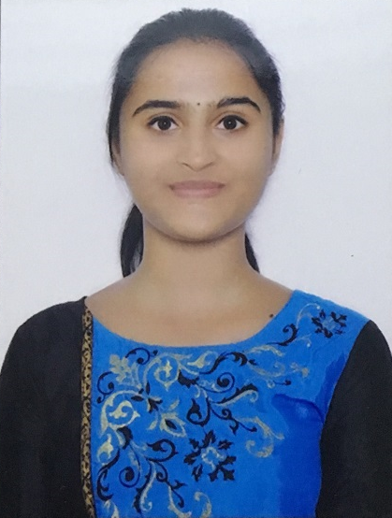
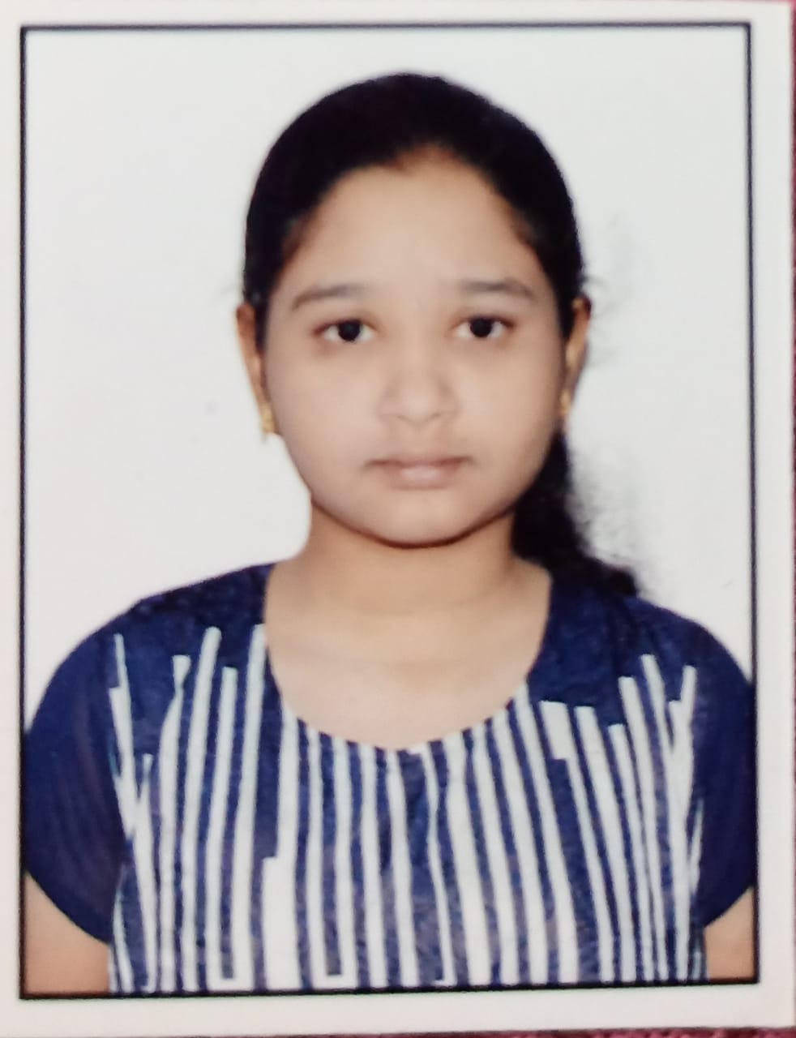
TEAM COMPOSITION
SL. NO | Name of the student | SRN | PHOTO
1 | Harshita R Vastrad | PES1201701717
2 | Shreya V Deexit | PES1201701648
3 | V Saisri | PES1201701763
Guide : Dr. B. Niranjana Krupa
Prof. Swetha G
6/05/2021
Robotic Arm BCI
‹#›

Slide 3
PROBLEM STATEMENT
To use Brain computer interface(BCI) to interact between robot and human, without participation of human hand and assist the patient impaired by neurological conditions
The robotic arm will be able to pick up lightweight objects like medicines, water bottle etc. from one place as interpreted from the brain waves of the user and drop it to a predefined location
6/05/2021
Robotic Arm BCI
‹#›

Slide 4
OBJECTIVE
To use brain waves to control robotic arm movement:
Pre-processing the dataset,
classifying and sending the classified signal output to robot for arm movement.
Image processing for recognition of objects to pick and drop:
This process involves object detection.
The robot will be able to
detect objects,
Avoid obstacles,
pick and drop the detected object.
The outcome of this process is movement of the robotic arm without any motion or gesture in the patients.
6/05/2021
Robotic Arm BCI
‹#›

Slide 5
LITERATURE SURVEY
(i) C P Shantala,C R Rashmi,“Mind controlled wireless robotic arm”,2017 IEEE International Conference on Computational intelligence and computing research.
Objective : The robotic arm interfacing was done using Matlab and Arduino board. Bluetooth module controls the robotic arm wirelessly.
Dataset : The EEG signals were collected from 14 healthy subjects by using the EEG headset.
Methodology : Three different classification algorithms like SVM, KNN and LDA are considered for classification.
Accuracy : LDA-87.5%
Void : The robotic arm is capable of moving only in 2D plane.Forward and backward movements of the arm are not implemented. It cannot be used for long distance control since Bluetooth range of transmission is less.
6/05/2021
Brain-Controlled Robotic Arm using BCI
‹#›

Slide 6
LITERATURE SURVEY
ii) Ana Riza F. Quiros,Alexander C. Abad,Elmer P. Dadios,”Object locator and collector robotic arm using artificial neural networks”, 2015 International Conference on Humanoid, Nanotechnology, Information Technology,Communication and Control, Environment and Management (HNICEM)
Model : ANN with 1 input layer,1 hidden layer and 1 output layer. The object's location will be fed as an input to the neural network. The neural network will process this data such that it will output a set of three angles at each joint angle of the robotic arm.
Performance : The performance is measured in terms of the mean squared error (MSE) for each epoch. MSE decreased as the number of epochs increased
Void : A camera focusing on an object of interest will capture an image and detect the mentioned object
6/05/2021
Robotic Arm BCI
‹#›
Notes:
https://ieeexplore.ieee.org/document/7393209

Slide 7
LITERATURE SURVEY
(iii)Maryam Mohammadi; Mohammad Reza Mosavi,”Improving the efficiency of an EEG-based brain computer interface using Filter Bank Common Spatial Pattern”,2017 IEEE 4th International Conference on Knowledge-Based Engineering and Innovation (KBEI)
DATASET : Dataset 2a of BCI Competition IV that was presented by Graz University.
METHOD : Signals are filtered using 9 sub-bands: 4-8 Hz, 8-12 Hz, …, 36-40 Hz.Then Spatial Filtering Using Common Spatial Patterns is applied.Classifier used-Naïve Bayesian Classifier
RESULT : The performance was computed in terms of kappa .The proposed method has a mean kappa of 0.6.
VOID : The performance of four-class classification on the mentioned dataset can be improved.Should focus on all sections such as preprocessing, feature extraction, feature selection and classification
6/05/2021
Robotic Arm BCI
‹#›
Notes:
https://ieeexplore.ieee.org/document/8324921

Slide 8
LITERATURE SURVEY
iv)Pronadeep Bora; Vishwajit Nandi,”Low cost shadow function based articulated robotic arm”, 2015 International Conference on Energy, Power and Environment: Towards Sustainable Growth (ICEPE)
In choosing the material for the robotic arm frame and its shape, the following factors were taken under consideration:
Cost
Weight of robot
Ease of manufacturing the parts
Ease of assembly
Strength and durability of the parts
The basic requirements for efficient transmission of power of the robotic arm are:
Small size
Low weight and moment of inertia
High effective stiffness
Low energy losses
The servo motors are used for rotating the arm
6/05/2021
Robotic Arm BCI
‹#›
Notes:
https://ieeexplore.ieee.org/document/7510079

Slide 9
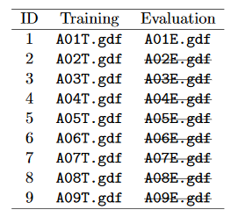
DATASET
BCI Competition 2008 – Graz data set A :
9 participants . 4 classes. Left hand,Right hand, Feet, Tongue.
22 EEG signals, 3 EOG signals(for eye movements)
Signals were sampled at 250Hz, and bandpass 0.5Hz and 100Hz,The sensitivity of the amplifier was set to 100μV. An additional 50 Hz notch filter was enabled to suppress line noise.
Files are in .gdf format
Files in the dataset:
6/05/2021
Robotic Arm BCI
‹#›

Slide 10
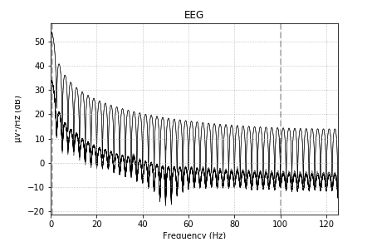
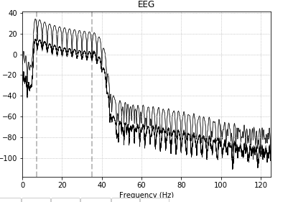
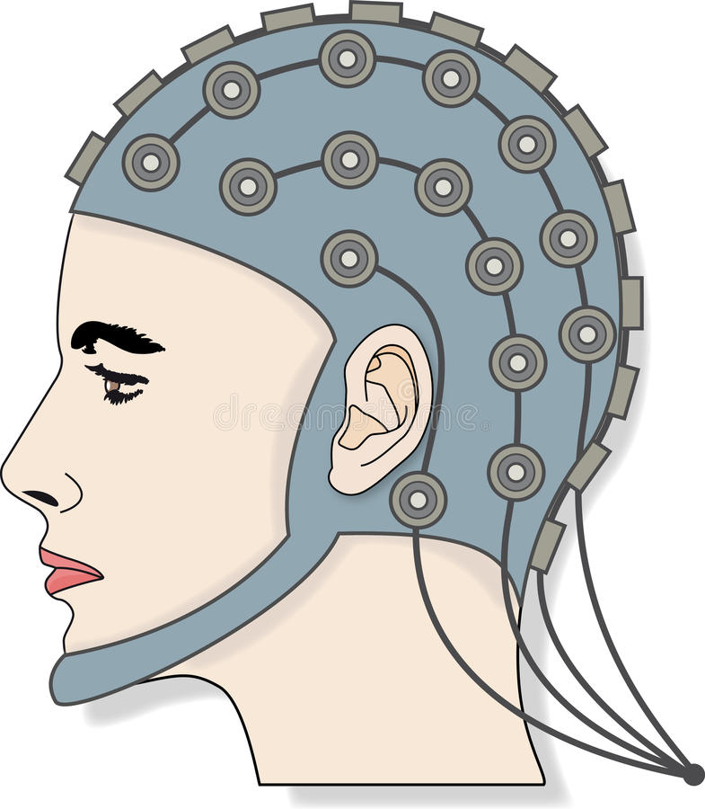
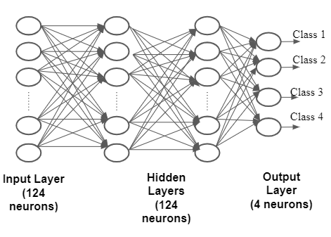
BLOCK DIAGRAM
Bandpass filter
Rename channels
Wavelet Packet Decomposition
Select 22 channels
25 channels
288, 22, 751
FIR filter parameters:
Hamming window
Lower passband edge: 7.00
Upper passband edge: 35.00 Hz
Order :4
bads: 3 items (EOG-left, EOG-central, EOG-right)
288, 22, 751
Train test split
80:20
Test: 58,32
Train: 230,32
Raspberry Pi
camera
Robotic Arm
Raspberry Pi
6/05/2021
Robotic Arm BCI
‹#›

Slide 11
WORK FLOW CHART
Extracting the data
Find the events
Bandpass filter
Removing bad channels
Plotting desired epochs
Renaming the labels
10 fold cross validation
Model build
Wavelet packet decomposition
Metrics
6/05/2021
Robotic Arm BCI
‹#›

Slide 12
WORK DONE
Extracting the data
Find the events
Bandpass filter
Removing bad channels
Plotting desired epochs
Renaming the labels
10 fold cross validation
Model build
Wavelet packet decomposition
Metrics
6/05/2021
Robotic Arm BCI
‹#›

Slide 13
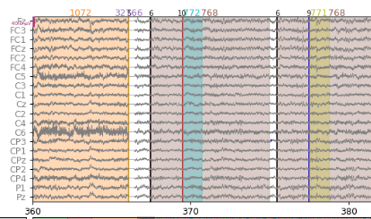
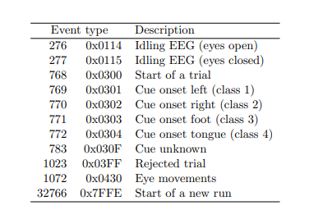
EVENTS
6/05/2021
Robotic Arm BCI
‹#›

Slide 14
METHOD
Extracting the data
Find the events
Bandpass filter
Removing bad channels
Plotting desired epochs
Renaming the labels
10 fold cross validation
Model build
Wavelet packet decomposition
Metrics
6/05/2021
Robotic Arm BCI
‹#›

Slide 15
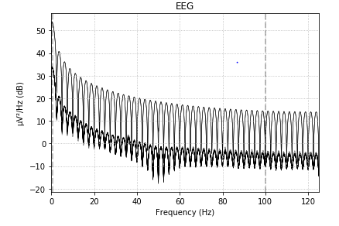
RESULT
Power Spectrum before Band pass filter
Power Spectrum after Band pass Filter Applied
6/05/2021
Robotic Arm BCI
‹#›

Slide 16
METHOD
Extracting the data
Find the events
Bandpass filter
Removing bad channels
Plotting desired epochs
Renaming the labels
10 fold cross validation
Model build
Wavelet packet decomposition
Metrics
6/05/2021
Robotic Arm BCI
‹#›

Slide 17
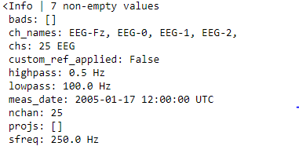
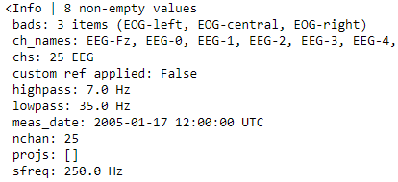
RESULT
6/05/2021
Robotic Arm BCI
‹#›

Slide 18
METHOD
Extracting the data
Find the events
Bandpass filter
Removing bad channels
Plotting desired epochs
Renaming the labels
10 fold cross validation
Model build
Wavelet packet decomposition
Metrics
6/05/2021
Robotic Arm BCI
‹#›

Slide 19
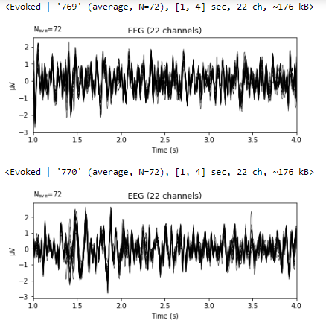
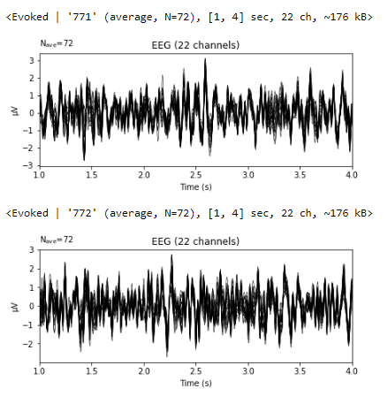
RESULTS
Left hand = 769
Right hand = 770
Foot = 771
Tongue = 772
6/05/2021
Robotic Arm BCI
‹#›
Notes:
Can add screenshots of plotted waveforms
Ica pictures
Accuracy screenshots

Slide 20
METHOD
Extracting the data
Find the events
Bandpass filter
Removing bad channels
Plotting desired epochs
Getting labels and changing labels from 7,8,9,10 -> 1,2,3,4
Renaming the labels
10 fold cross validation
Model build
Wavelet packet decomposition
Metrics
6/05/2021
Robotic Arm BCI
‹#›

Slide 21
METHOD
Extracting the data
Find the events
Bandpass filter
Removing bad channels
Plotting desired epochs
Renaming the labels
Metrics
10 fold cross validation
Model build
Wavelet packet decomposition
Signal is decomposed to level 5 with 'db4' wavelet.db4 is chosen due to their near optimal time frequency localisation properties.
6/05/2021
Robotic Arm BCI
‹#›

Slide 22
METHOD
Extracting the data
Find the events
Bandpass filter
Removing bad channels
Plotting desired epochs
Renaming the labels
Metrics
10 fold cross validation
Model build
Wavelet packet decomposition
8 frequency band coefficients are chosen from the range 4-32Hz
6/05/2021
Robotic Arm BCI
‹#›

Slide 23
METHOD
Extracting the data
Find the events
Bandpass filter
Removing bad channels
Plotting desired epochs
Renaming the labels
10 fold cross validation
Model build
Wavelet packet decomposition
Metrics
6/05/2021
Robotic Arm BCI
‹#›

Slide 24
MODEL
Class 1
Class 2
Class 3
Class 4
Input Layer
(124 neurons)
Hidden Layers
(124 neurons)
Output Layer
(4 neurons)
6/05/2021
Robotic Arm BCI
‹#›

Slide 25
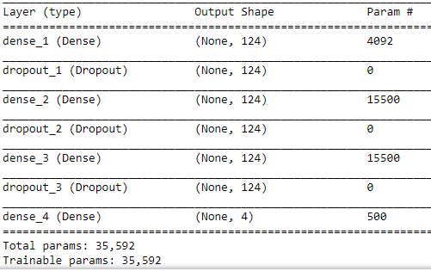
MODEL SUMMARY
Dropout : 0.5
L2 regularizer
Optimizer : rmsprop
2 Hidden Layers
loss = Categorical crossentropy
6/05/2021
Robotic Arm BCI
‹#›

Slide 26
METHOD
Extracting the data
Find the events
Bandpass filter
Removing bad channels
Plotting desired epochs
Renaming the labels
10 fold cross validation
Model build
Wavelet packet decomposition
Metrics
6/05/2021
Robotic Arm BCI
‹#›

Slide 27
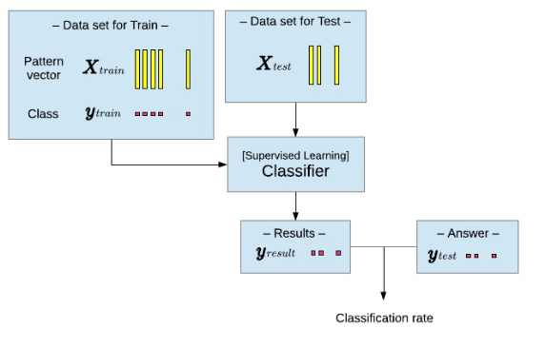
Train Test Split
20%
80%
ANN Model
6/05/2021
Robotic Arm BCI
‹#›

Slide 28
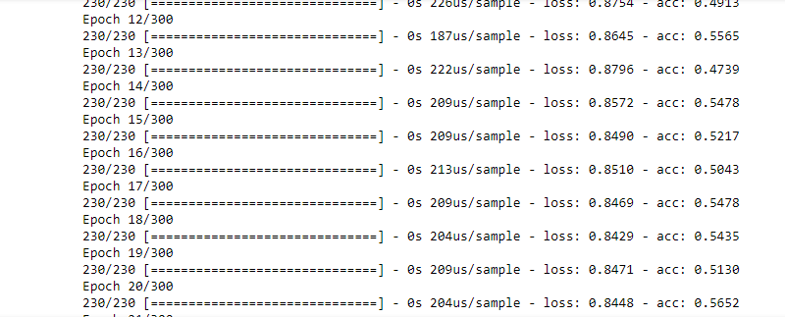
Training
From 288 data samples, 230 are used for training and rest 58 are used for testing. The model was initially trained on 230 with 300 epochs, after which the early stopping was implemented such that training loss never goes below validation loss.
Training phase
6/05/2021
Robotic Arm BCI
‹#›

Slide 29
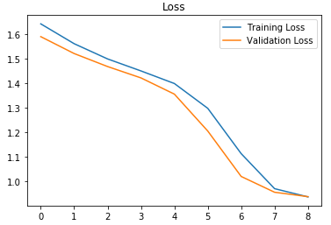
FINE TUNING
Early stopping
Too many epochs can lead to overfitting of the training dataset, whereas too few may result in an underfit model.
Early stopping is a method that allows to specify an arbitrary large number of training epochs and stop training once the model performance stops improving on a hold out validation dataset.
Plotting training and validation loss after applying early stopping
6/05/2021
Robotic Arm BCI
‹#›

Slide 30
METHOD
Extracting the data
Find the events
Bandpass filter
Removing bad channels
Plotting desired epochs
Renaming the labels
10 fold cross validation
Model build
Wavelet packet decomposition
Metrics
6/05/2021
Robotic Arm BCI
‹#›

Slide 31
VALIDATION
Fine tuning the model by varying different parameters
Parameters | Accuracy
Changing the optimizer (adam) | 68.27%
Changing drop out value(0.2) | 67.06%
Number of layers | 68.79% (Two hidden layers) 67.23% (Single hidden layer)
Early stopping | 70.6%
L2 Regularisation | 69.65%
6/05/2021
Robotic Arm BCI
‹#›

Slide 32
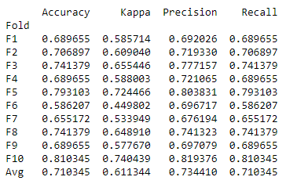
RESULT
After trying many variations in the model, this is the best accuracy we have got
6/05/2021
Robotic Arm BCI
‹#›

Slide 33
CONSTRAINTS
Colored objects are considered to be Lightweight objects
Input given to robotic arm and object color that has to be picked
Class 1 - Left - Orange
Class 2 - Right - Red
Class 3 - Front - Blue
Class 4 - Back - Green
Based on the input Robotic arm rotates and moves in that direction,
detecting the colored object.
6/05/2021
Robotic Arm BCI
‹#›

Slide 34

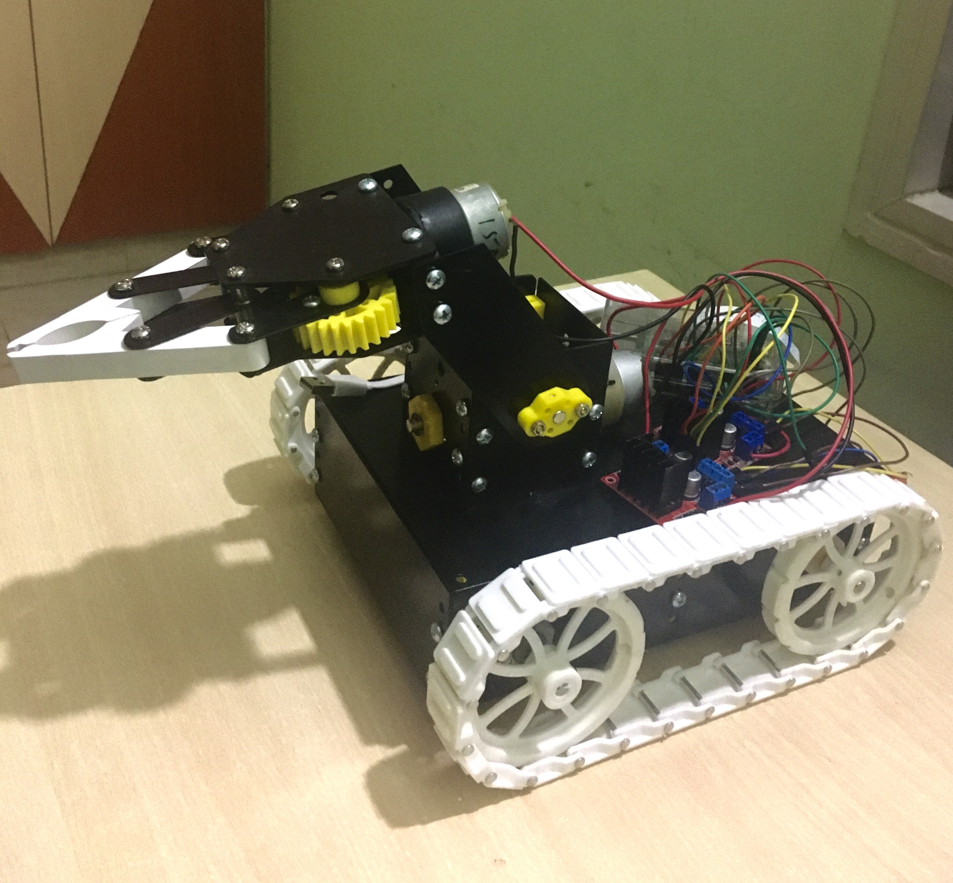




MOTOR MOVEMENTS
Robotic Arm
Path followed by robotic arm
6/05/2021
Robotic Arm BCI
‹#›

Slide 35
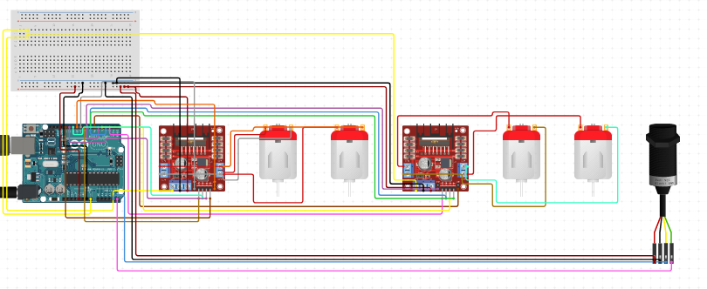
CIRCUIT DIAGRAM
Component Specifications:
4 DC motors
Two motors for controlling wheels and the other two to control robotic arm
2 H-bridge
To control DC motors
Pi Camera
For object colour detection
Raspberry Pi 3 Model A+ processor
Raspberry Pi
6/05/2021
Robotic Arm BCI
‹#›

Slide 36
TENSORFLOW SETUP
The model weights were saved and sent to the raspbian OS using SCP(Secure copy).Scp is a command for sending files over SSH. This is used to copy files between computers, say from your Raspberry Pi to your desktop or laptop, or vice-versa.
Transfer files :
scp saved_model pi@192.168.1.3:
Then using the tensorflow load module (load_model) we loaded the model on Raspberry Pi and provided the input to the model which has the dimension of 230x32. The model accordingly classifies the input and provides us the class number.
6/05/2021
Robotic Arm BCI
‹#›

Slide 37
INSTALLING MODULES
Cmake
Libjpeg-dev,Libpng-dev,Libtiff-dev
Libavcodec-dev,Libavformat-dev,Libswscale-dev,Libv4l-dev
Libxvidcore-dev,Libx264-dev
Libgtk-3-dev
Libatlas-base-dev gfortran
python3-dev
OpenCV
6/05/2021
Robotic Arm BCI
‹#›

Slide 38
WORKFLOW
Get image frames from video
Convert BGR color space to HSV color space
Define the range and create mask
Capture video through pi camera
Create contour to track color
Bitwise and between image frame and mask
Color detection
Dilation
6/05/2021
Robotic Arm BCI
‹#›

Slide 39
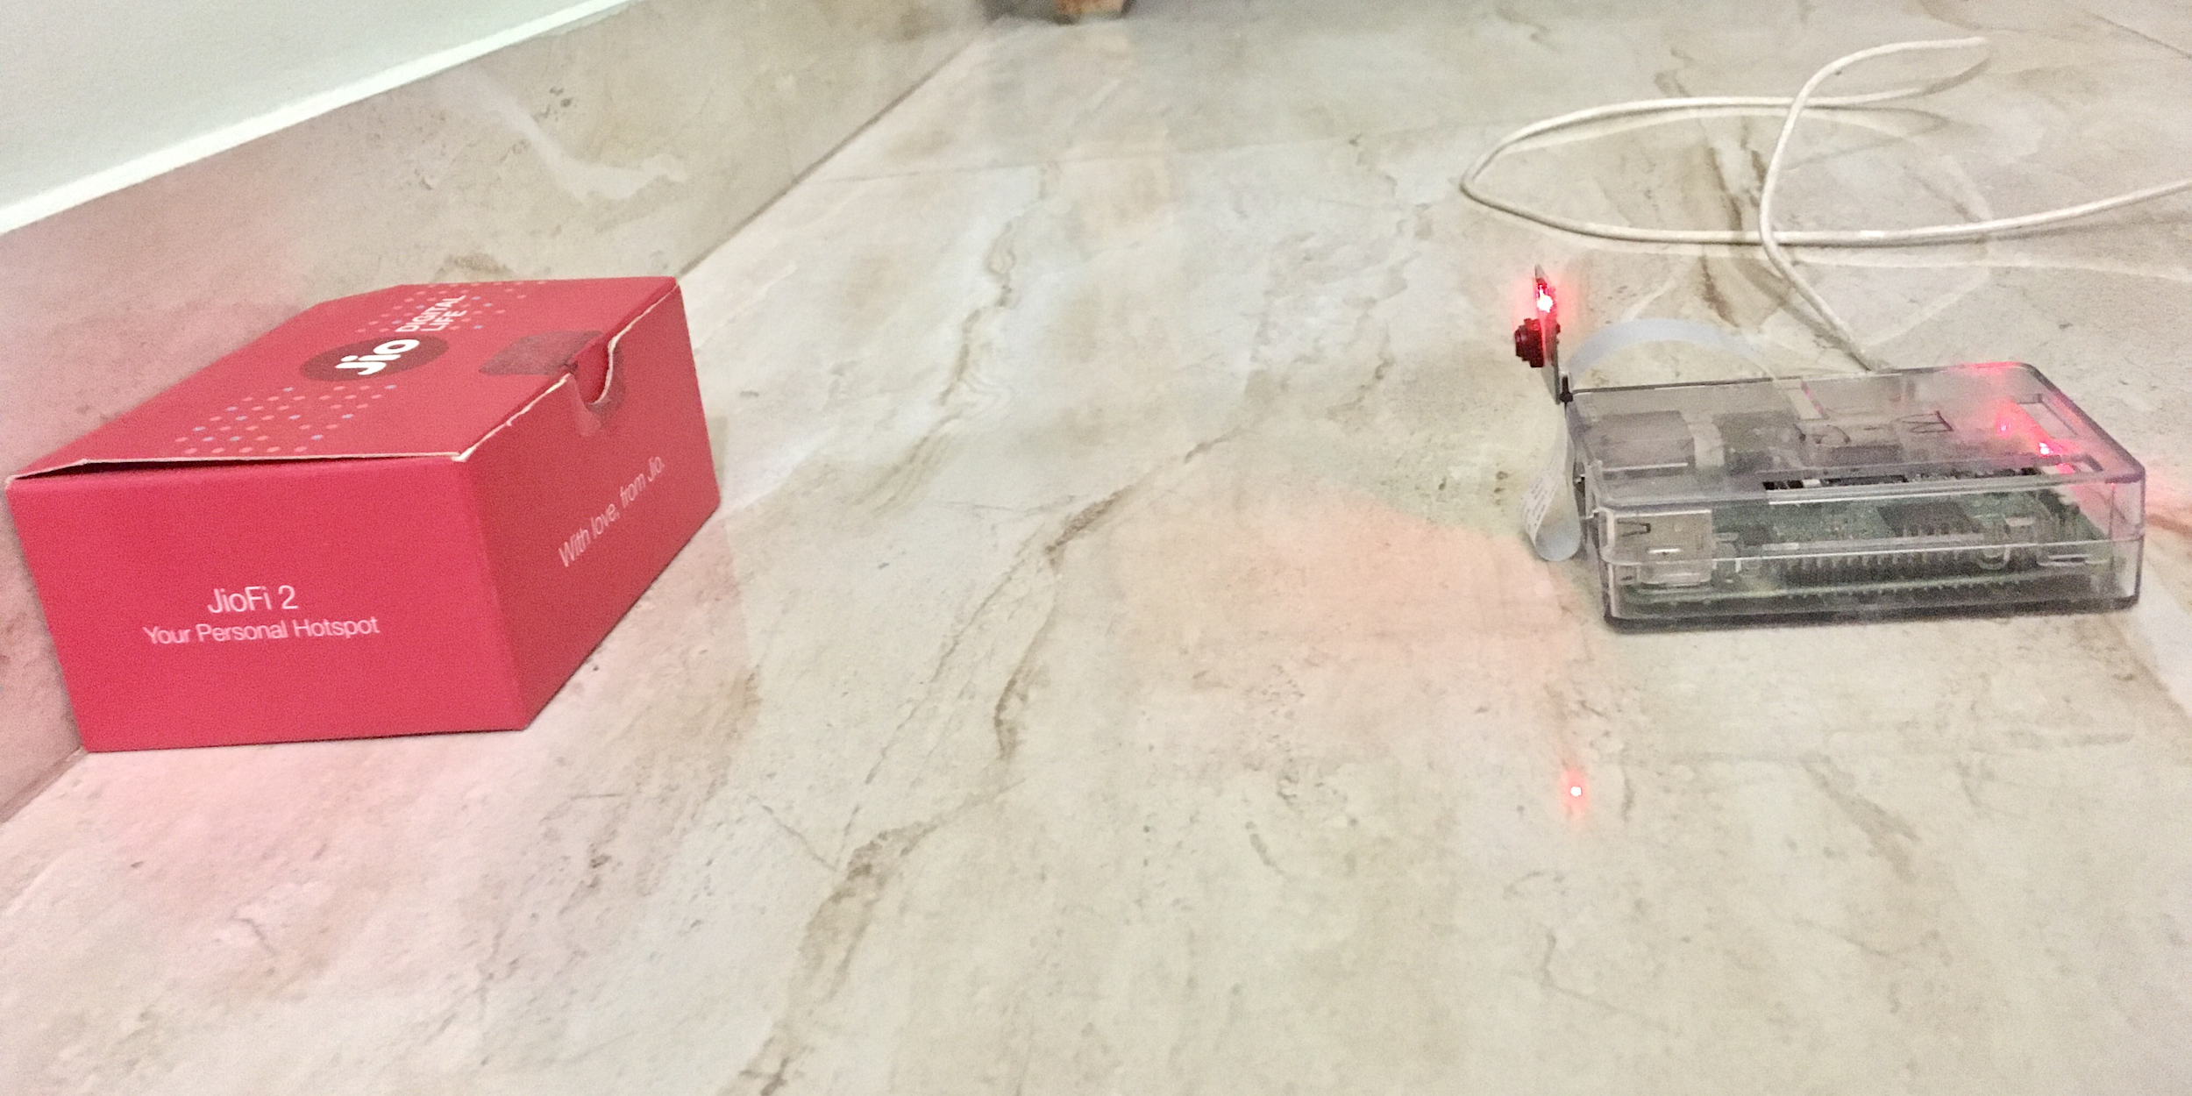
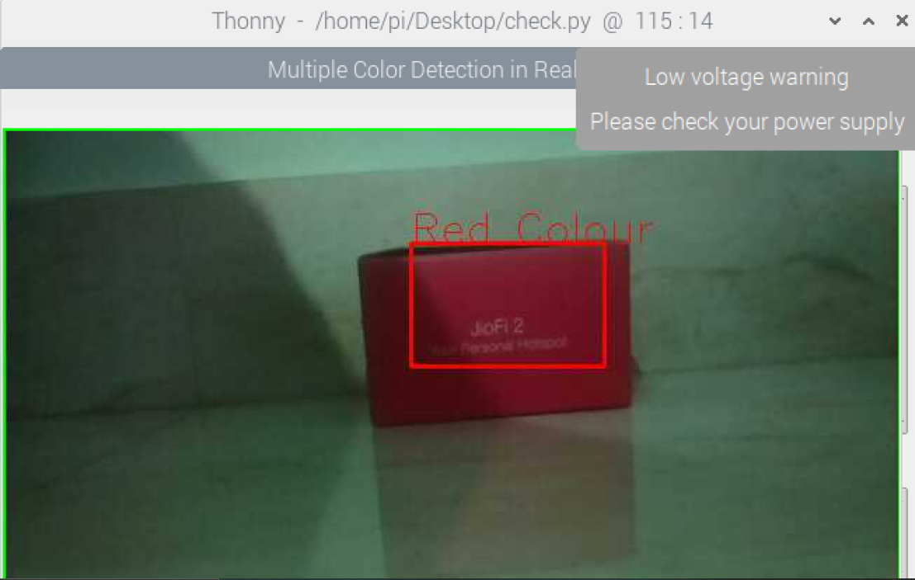
OBJECT COLOR DETECTION
Setup for colour detection
Image showing the output of detected red coloured object
6/05/2021
Robotic Arm BCI
‹#›

Slide 40
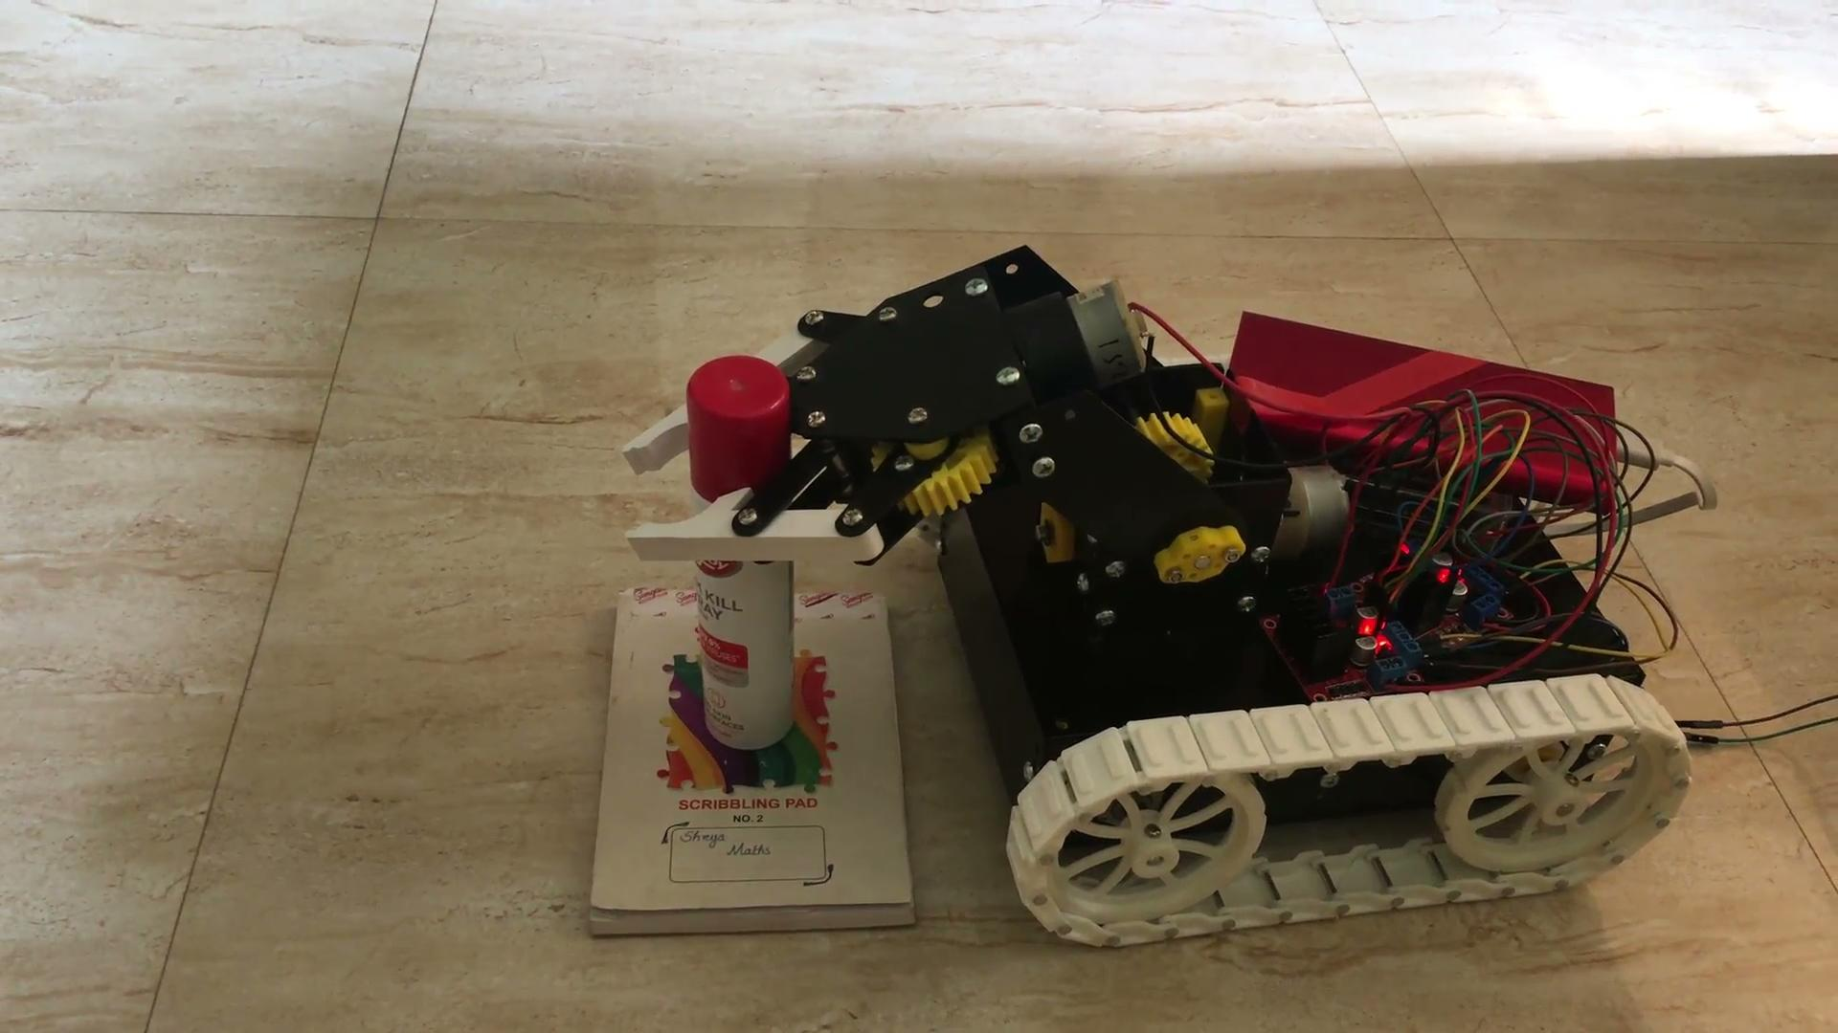
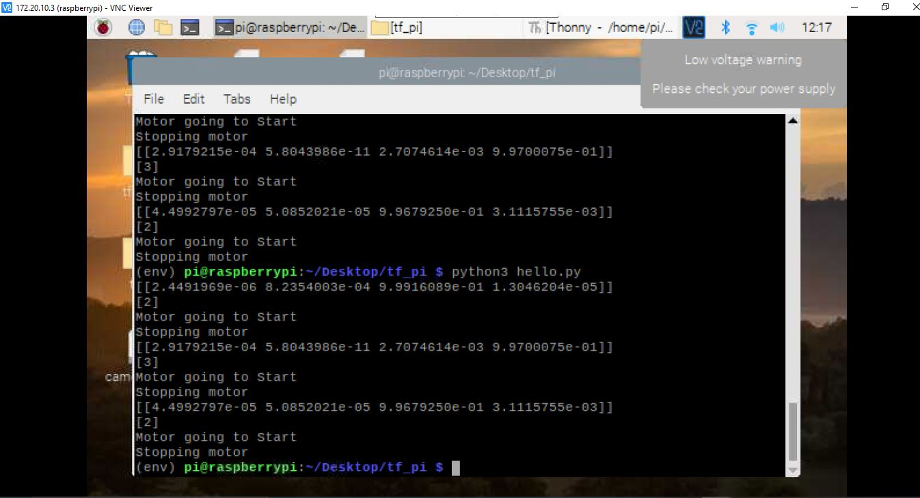
DEMO
Snapshot of Raspberry Pi terminal
6/05/2021
Robotic Arm BCI
‹#›

Slide 41
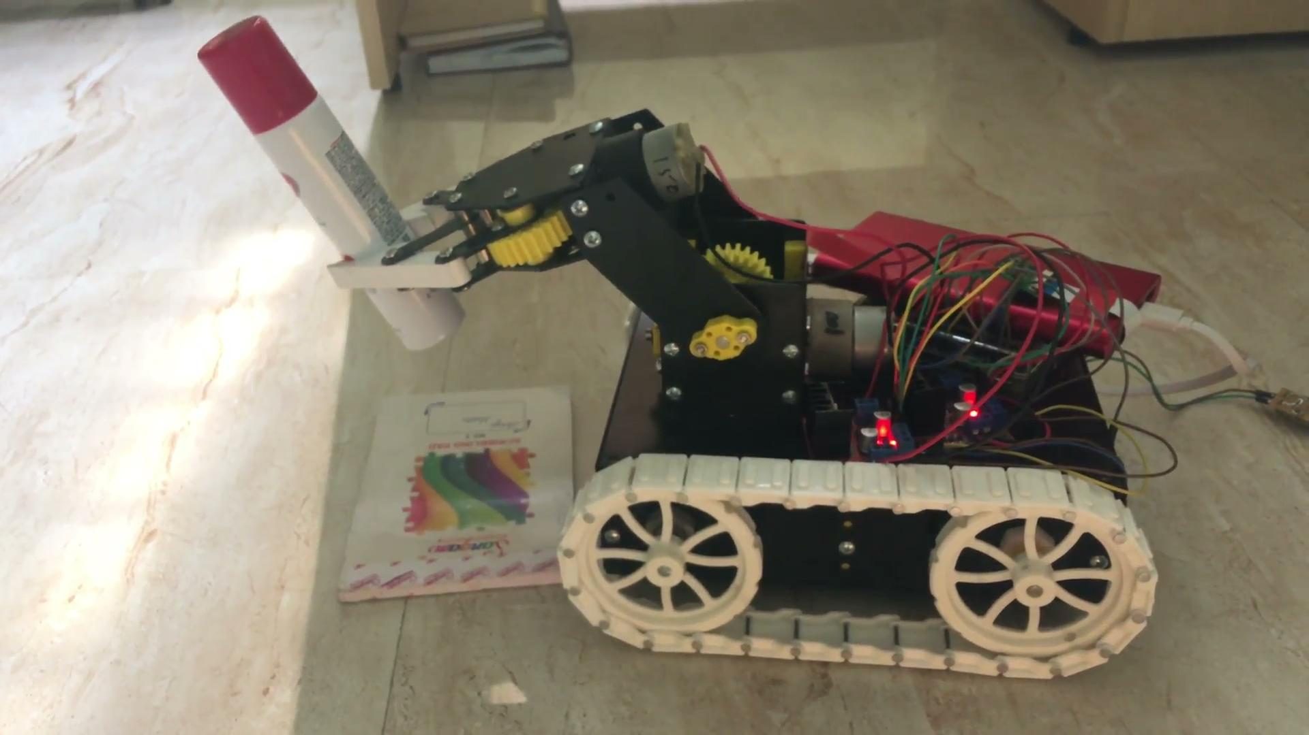
DEMO
6/05/2021
Robotic Arm BCI
‹#›

Slide 42
Validation and Future Scope
The region where the project is to conducted should have an excellent lighting framework, since there is an object colour recognition included
The items which should be picked by the robotic arm should be light weight.
The colors are predefined to detect objects easily
The test environment should not have any obstacle.
6/05/2021
Robotic Arm BCI
‹#›

Slide 43
REFERENCES
Pronadeep Bora; Vishwajit Nandi,”Low cost shadow function based articulated robotic arm”, 2015 International Conference on Energy, Power and Environment: Towards Sustainable Growth (ICEPE)
Ana Riza F. Quiros,Alexander C. Abad,Elmer P. Dadios,”Object locator and collector robotic arm using artificial neural networks”, 2015 International Conference on Humanoid, Nanotechnology, Information Technology,Communication and Control, Environment and Management (HNICEM)
Son Ngoc Truong Faculty of Electrical and Electronics Engineering HCMC University of Technology and Education,”A Low-cost Artificial Neural Network Model for Raspberry Pi”Engineering, Technology & Applied Science Research
Running a Convolutional Neural Network on Raspberry PI https://medium.com/swlh/running-a-convolutional-neural-network-on-raspberry-pi-4fc5bd80aa4d
6/05/2021
Robotic Arm BCI
‹#›

Slide 44
THANK YOU...
6/05/2021
Robotic Arm BCI
‹#›

